Slide 1
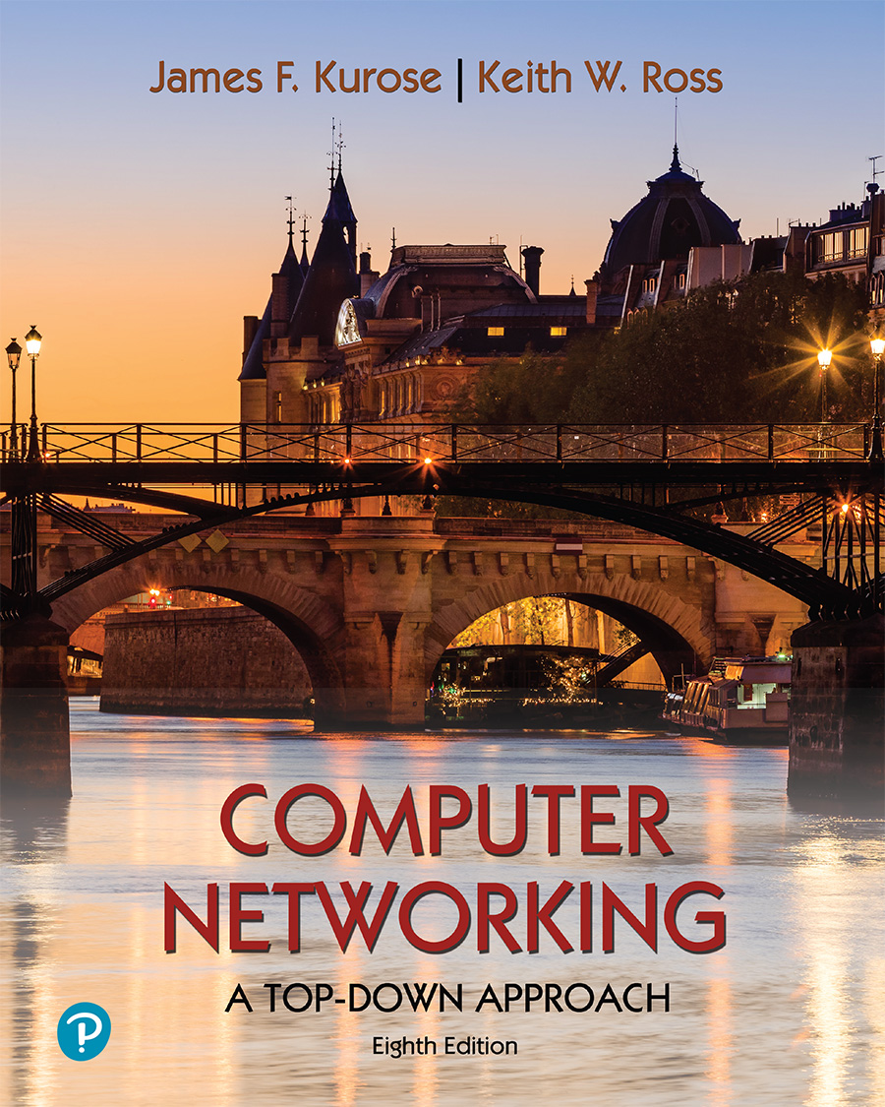
Chapter 5
Network Layer:
Control Plane
A note on the use of these PowerPoint slides:
We’re making these slides freely available to all (faculty, students, readers). They’re in PowerPoint form so you see the animations; and can add, modify, and delete slides (including this one) and slide content to suit your needs. They obviously represent a lot of work on our part. In return for use, we only ask the following:
If you use these slides (e.g., in a class) that you mention their source (after all, we’d like people to use our book!)
If you post any slides on a www site, that you note that they are adapted from (or perhaps identical to) our slides, and note our copyright of this material.
For a revision history, see the slide note for this page.
Thanks and enjoy! JFK/KWR
All material copyright 1996-2020
J.F Kurose and K.W. Ross, All Rights Reserved
Computer Networking: A Top-Down Approach
8th edition
Jim Kurose, Keith Ross
Pearson, 2020
Notes:
Version History
8.0 (May 2020)
All slides reformatted for 16:9 aspect ratio
All slides updated to 8th edition material
Use of Calibri font, rather that Gill Sans MT
Add LOTS more animation throughout
lighter header font
Re-do of network management slides; redo of Bellman-Ford slides

Slide 2
Network layer control plane: our goals
understand principles behind network control plane:
  traditional routing algorithms
  SDN controllers
  network management, configuration
instantiation, implementation in the Internet:
  OSPF, BGP
  OpenFlow, ODL and ONOS controllers
  SNMP, YANG/NETCONF (NOT COVERED)

Slide 3

Network layer: “control plane” roadmap
introduction
routing protocols
  link state
  distance vector
intra-ISP routing: OSPF
routing among ISPs: BGP
SDN control plane
Internet Control Message Protocol (ICMP)
network management, configuration
  SNMP
  NETCONF/YANG (NOT COVERED)

Slide 4
Network-layer functions
forwarding: move packets from router’s input to appropriate router output
data plane
routing: determine route taken by packets from source to destination
control plane
Two approaches to structuring network control plane:
per-router control (traditional)
logically centralized control (software defined networking)

Slide 5
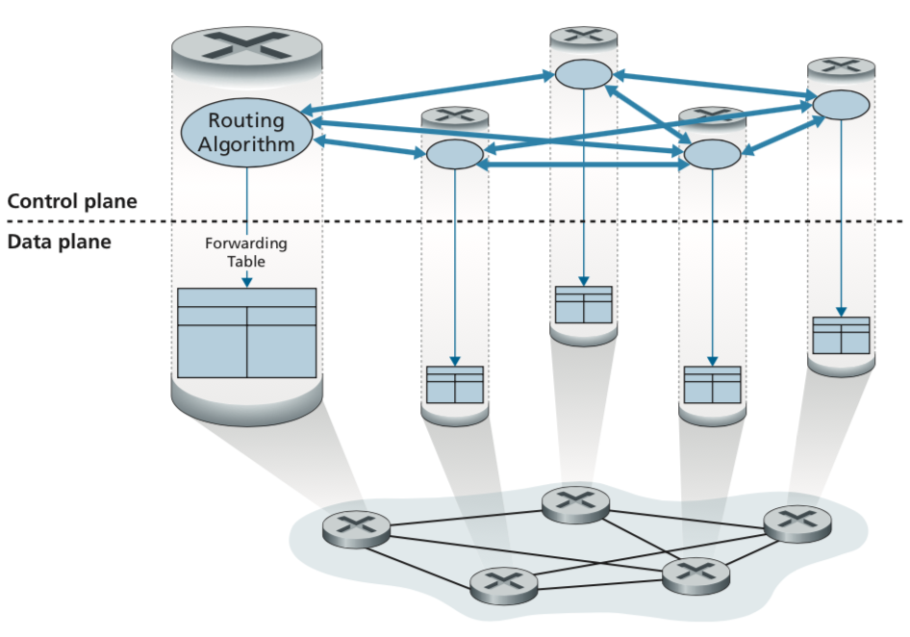
Introduction
Recalling the next figures for forwarding table and the flow table were the principal elements that linked the network layer’s data plane and control plane.
Figure:
Per-router control: Individual routing algorithm components interact in the control plane
Kurose, J.F. and Ross, K.W. (2021). Computer Networking: A Top-Down Approach (8th Edition). Pearson Education Limited, England. (pp. 378)

Slide 6

Introduction
Recalling the next figures for forwarding table and the flow table were the principal elements that linked the network layer’s data plane and control plane.
These tables specify the local data-plane forwarding behavior of a router.
The case of generalized forwarding is not only forwarding a packet to a router’s output port, but also dropping a packet and replicating a packet.
In this chapter 5,
we’ll study how those forwarding and flow tables are computed, maintained and installed.
Figure:
Per-router control: Individual routing algorithm components interact in the control plane
Kurose, J.F. and Ross, K.W. (2021). Computer Networking: A Top-Down Approach (8th Edition). Pearson Education Limited, England. (pp. 378)

Slide 7
Introduction
(a) Per-router control:
Two Approaches
The OSPF and BGP protocols
Section 5.3
Figure:
Per-router control: Individual routing algorithm components interact in the control plane
OSPF (Open Shortest Part First)
BGP (Border Gateway Protocol):
Kurose, J.F. and Ross, K.W. (2021). Computer Networking: A Top-Down Approach (8th Edition). Pearson Education Limited, England. (pp. 378)

Slide 8
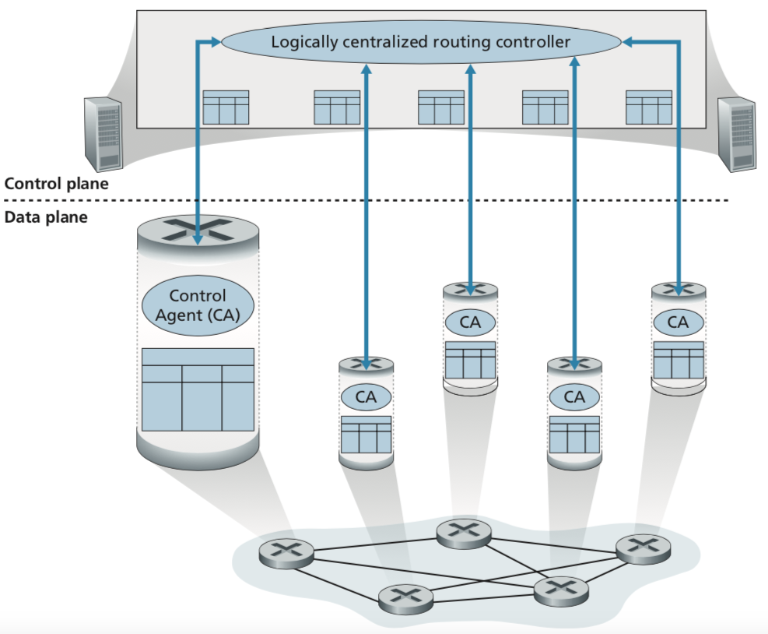
Introduction
Two Approaches
(b) Logically centralized control (SDN)
generalized match-plus-action abstraction allows the router to perform traditional IP forwarding.
The SDN
Section 5.5
Figure:
Logically centralized control: A distinct, typically remote, controller interacts with local Control Agents (CAs)
CAs communicate with the controller
Kurose, J.F. and Ross, K.W. (2021). Computer Networking: A Top-Down Approach (8th Edition). Pearson Education Limited, England. (pp. 379)
Notes:
The controller interacts with a control agent (CA) in each of the routers via a well-defined protocol to configure and manage that router’s flow table. Typically, the CA has minimum functionality; its job is to communicate with the controller, and to do as the controller commands. Unlike the routing algorithms in Figure 5.1, the CAs do not directly interact with each other nor do they actively take part in computing the forwarding table. This is a key distinction between per-router control and logically centralized control.

Slide 9
Network layer: “control plane” roadmap
introduction
routing protocols
  link state
  distance vector
intra-ISP routing: OSPF
routing among ISPs: BGP
SDN control plane
Internet Control Message Protocol (ICMP)
network management, configuration
  SNMP
  NETCONF/YANG (NOT COVERED)

Slide 10
















Routing protocols
mobile network
Routing protocol goal: determine “good” paths (equivalently, routes), from sending hosts to receiving host, through network of routers
path: sequence of routers packets traverse from given initial source host to final destination host
“good”: least “cost”, “fastest”, “least congested”
routing: a “top-10” networking challenge!
national or global ISP
application
transport
network
link
physical
network
link
physical
network
link
physical
network
link
physical
network
link
physical
network
link
physical
datacenter
network
application
transport
network
link
physical
enterprise
network

Slide 11
Graph abstraction: link costs
5
c_{a,b}: cost of direct link connecting a and b
e.g., c_{w,z} = 5, c_{u,z} = ∞
  cost defined by network operator: could always be 1, or inversely related to bandwidth, or inversely related to congestion
v
3
w
2
5
u
2
1
z
3
1
2
x
y
1
graph: G = (N,E)
N: set of routers = { u, v, w, x, y, z }
E: set of links ={ (u,v), (u,x), (v,x), (v,w), (x,w), (x,y), (w,y), (w,z), (y,z) }

Slide 12
Routing algorithm classification
global: all routers have complete topology, link cost info
“link state” algorithms
dynamic: routes change more quickly
  periodic updates or in response to link cost changes
How fast do routes change?
static: routes change slowly over time
decentralized: iterative process of computation, exchange of info with neighbors
routers initially only know link costs to attached neighbors
“distance vector” algorithms
global or decentralized information?

Slide 13
Network layer: “control plane” roadmap
introduction
routing protocols
  link state
  distance vector
intra-ISP routing: OSPF
routing among ISPs: BGP
SDN control plane
Internet Control Message Protocol (ICMP)
network management, configuration
  SNMP
  NETCONF/YANG (NOT COVERED)

Slide 14
Dijkstra’s link-state routing algorithm
centralized: network topology, link costs known to all nodes
  accomplished via “link state broadcast”
  all nodes have same info
computes least cost paths from one node (“source”) to all other nodes
  gives forwarding table for that node
iterative: after k iterations, know least cost path to k destinations
notation
c_{x,y}: direct link cost from node x to y; = ∞ if not direct neighbors
D(v): current estimate of cost of least-cost-path from source to destination v
p(v): predecessor node along path from source to v
N': set of nodes whose least-cost-path definitively known

Slide 15
Dijkstra’s link-state routing algorithm
1 Initialization:
2 N' = {u} /* compute least cost path from u to all other nodes */
3 for all nodes v
4 if v adjacent to u /* u initially knows direct-path-cost only to direct neighbors */
5 then D(v) = c_{u,v} /* but may not be minimum cost! */
6 else D(v) = ∞
7
8 Loop
9
10
11
12
13
14
15 until all nodes in N'
find w not in N' such that D(w) is a minimum
add w to N'
update D(v) for all v adjacent to w and not in N' :
D(v) = min ( D(v), D(w) + c_{w,v} )
/* new least-path-cost to v is either old least-cost-path to v or known
least-cost-path to w plus direct-cost from w to v */

Slide 16
Dijkstra’s algorithm: an example
v
w
x
y
z
Step
0
1
2
3
4
5
N'
D(v),p(v)
D(w),p(w)
D(x),p(x)
D(y),p(y)
D(z),p(z)
u
2,u
5,u
1,u
∞
∞
ux
2,u
4,x
2,x
∞
uxy
2,u
3,y
4,y
uxyv
3,y
4,y
D(w),p(w)
5,u
4,x
3,y
3,y
uxyvw
4,y
uxyvwz
Initialization (step 0): For all a: if a adjacent to then D(a) = c_{u,a}
5
find a not in N' such that D(a) is a minimum
add a to N'
update D(b) for all b adjacent to a and not in N' :
D(b) = min ( D(b), D(a) + c_{a,b} )
v
3
w
2
5
u
2
1
z
3
1
2
x
y
1

Slide 17
Dijkstra’s algorithm: an example
5
v
3
w
2
5
u
2
1
z
3
1
2
x
y
1
resulting least-cost-path tree from u:
resulting forwarding table in u:
v
w
destination
outgoing link
v
x
y
w
z
(u,v)
(u,x)
(u,x)
(u,x)
(u,x)
route from u to v directly
u
z
x
route from u to all other destinations via x
y

Slide 18
Dijkstra’s algorithm: another example
v
w
x
y
z
x
D(v),
p(v)
D(w),
p(w)
D(x),
p(x)
D(y),
p(y)
D(z),
p(z)
9
Step
N'
0
u
7,u
3,u
5,u
∞
∞
5
7
4
1
uw
6,w
5,u
11,w
∞
8
2
uwx
6,w
11,w
14,x
u
3
w
y
z
2
3
uwxv
10,v
14,x
3
4
uwxvy
12,y
7
4
5
uwxvyz
v
notes:
construct least-cost-path tree by tracing predecessor nodes
ties can exist (can be broken arbitrarily)

Slide 19
Dijkstra’s algorithm: discussion
algorithm complexity: n nodes
each of n iteration: need to check all nodes, w, not in N
n(n+1)/2 comparisons: O(n²) complexity
more efficient implementations possible: O(nlogn)
message complexity:
each router must broadcast its link state information to other n routers
efficient (and interesting!) broadcast algorithms: O(n) link crossings to disseminate a broadcast message from one source
each router’s message crosses O(n) links: overall message complexity: O(n²)

Slide 20
Dijkstra’s algorithm: oscillations possible
when link costs depend on traffic volume, route oscillations possible
sample scenario:
  routing to destination a, traffic entering at d, c, e with rates 1, e (<1), 1
  link costs are directional, and volume-dependent
a
a
a
a
1
1+e
2+e
0
0
2+e
2+e
0
d
b
d
1
b
d
b
d
b
0
0
1+e
0
0
1+e
1
1
0
e
1
0
c
0
1
1
1
c
1+e
1
1
0
0
1
c
1
c
e
e
e
e
given these costs,
find new routing….
resulting in new costs
given these costs,
find new routing….
resulting in new costs
given these costs,
find new routing….
resulting in new costs
initially

Slide 21
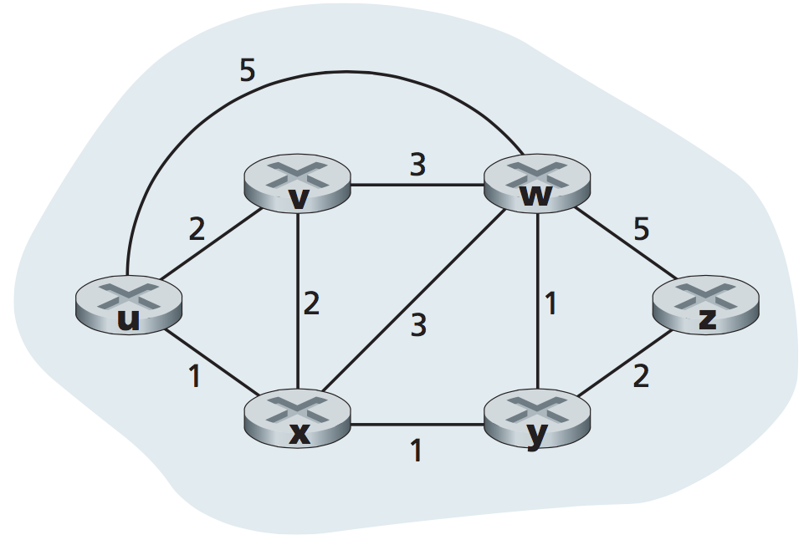
Exercise 5.0
Dijkstra’s Algorithm
Routers in nodes u, v, w, x, y and z have been assigned with link cost value as stated in the diagram.
Construct table least cost paths from node z to node u
    construct shortest path tree by tracing predecessor nodes
Computes least cost paths from node z to node u
Produce forwarding table for node z

Slide 22
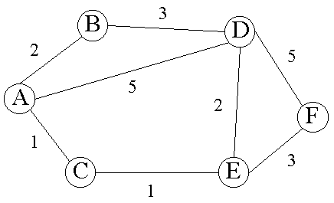
Exercise 5.1
Routers in nodes A, B, C, D, E and F have been assigned with link cost value as stated in the diagram.
Construct table least cost paths from node A to node F using Dijkstra’s algorithm
Draw least cost paths from node A to node F
Produce forwarding table for node A
http://www4.ncsu.edu/~chou/course/Diagrams/distance-vector.gif

Slide 23
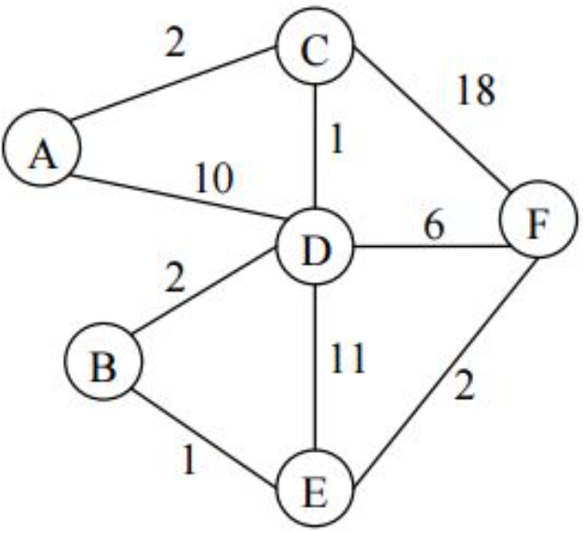
Exercise 5.2
Routers in nodes A, B, C, D, E, and F have been assigned with link cost value as stated in the diagram.
Construct table least cost paths from node D to node H using Dijkstra’s algorithm
Draw least cost paths from node D to node H
Produce forwarding table for node D
https://i.stack.imgur.com/bcz2a.jpg

Slide 24
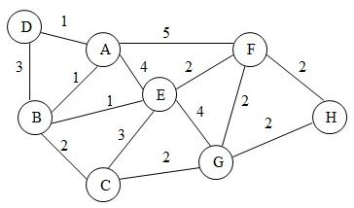
Exercise 5.3
Routers in nodes A, B, C, D, E, F, G and H have been assigned with link cost value as stated in the diagram.
Construct table least cost paths from node D to node H using Dijkstra’s algorithm
Draw least cost paths from node D to node H
Produce forwarding table for node D
http://s3.amazonaws.com/answer-board-image/6bfef7b5-05b9-4210-afb5-712510e57a37.jpeg

Slide 25
Network layer: “control plane” roadmap
introduction
routing protocols
  link state
  distance vector
intra-ISP routing: OSPF
routing among ISPs: BGP
SDN control plane
Internet Control Message Protocol (ICMP)
network management, configuration
  SNMP
  NETCONF/YANG (NOT COVERED)

Slide 26
Distance vector algorithm
Based on Bellman-Ford (BF) equation (dynamic programming):
Bellman-Ford equation
Let D_{x}(y): cost of least-cost path from x to y.
Then:
D_{x}(y) = min_{v} { c_{x,v} + D_{v}(y) }
v’s estimated least-cost-path cost to y
min taken over all neighbors v of x
direct cost of link from x to v

Slide 27
Distance vector algorithm
key idea:
from time-to-time, each node sends its own distance vector estimate to neighbors
when x receives new DV estimate from any neighbor, it updates its own DV using B-F equation:
D_{x}(y) ← min_{v}{c_{x,v} + D_{v}(y)} for each node y ∊ N
under minor, natural conditions, the estimate D_{x}(y) converge to the actual least cost d_{x}(y)

Slide 28


The Distance Vector (DV)
Bellman-Ford
d_{x}(y)
x
v
y
Bellman-Ford equation (dynamic programming)
let → cost of least-cost path from x to y
then
c(x,v)
d_{v}(y)
under minor, natural conditions, the estimate
converge to the actual least cost

Slide 29
The Distance Vector (DV)
Bellman-Ford
Example:
Neighbor to u are v, x, and w;
u
c(u,v)
d_{v}(z)
v
c(u,x)
d_{x}(z)
u
x
z
c(u,w)
d_{w}(z)
w

Slide 30

The Distance Vector (DV)
Bellman-Ford
Clearly,
v
w
x
c(u,v)
d_{v}(z)
v
c(u,x)
d_{x}(z)
u
x
z
c(u,w)
d_{w}(z)
w

Slide 31
Bellman-Ford Example
Suppose that u’s neighboring nodes, x,v,w, know that for destination z:
D_{v}(z) = 5
D_{w}(z) = 3
Bellman-Ford equation says:
5
D_{u}(z) = min { c_{u,v} + D_{v}(z),
c_{u,x} + D_{x}(z),
c_{u,w} + D_{w}(z) }
v
3
w
2
5
u
2
1
z
3
= min {2 + 5,
1 + 3,
5 + 3} = 4
1
2
x
y
1
D_{x}(z) = 3
node achieving minimum (x) is next hop on estimated least-cost path to destination (z)

Slide 32
Exercise 5.4
Calculate the cost from z to u by using the Bellman-Ford algorithm.

Slide 33
Exercise 5.6
Using the Bellman-Ford algorithm to calculate the cost from:
(a) A to F
(b) B to E
(c) F to B
http://www4.ncsu.edu/~chou/course/Diagrams/distance-vector.gif

Slide 34
Exercise 5.7
Using the Bellman-Ford algorithm to calculate the cost from:
(a) A to F
(b) B to C
(c) F to B
https://i.stack.imgur.com/bcz2a.jpg

Slide 35
Exercise 5.8
Using the Bellman-Ford algorithm to calculate the cost from:
(a) D to E
(b) D to H
(c) H to B
(d) F to D
(e) A to E
http://s3.amazonaws.com/answer-board-image/6bfef7b5-05b9-4210-afb5-712510e57a37.jpeg

Slide 36
Distance vector algorithm:
each node:
iterative, asynchronous: each local iteration caused by:
local link cost change
DV update message from neighbor
wait for (change in local link cost or msg from neighbor)
recompute DV estimates using DV received from neighbor
distributed, self-stopping: each node notifies neighbors only when its DV changes
  neighbors then notify their neighbors – only if necessary
  no notification received, no actions taken!
if DV to any destination has changed, notify neighbors

Slide 37
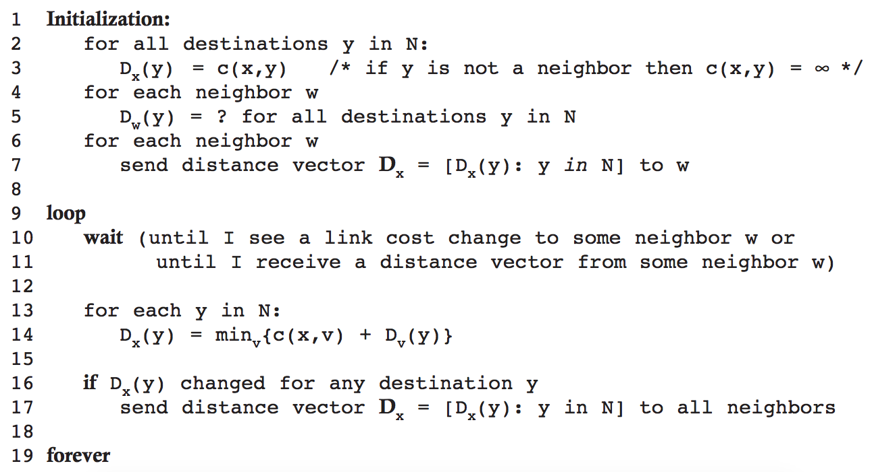
The Distance Vector (DV)
Figure: DV algorithm at each node, x

Slide 38
Distance vector: another example
D_{x}()
cost to
cost to
x y z
x y z
x
0 2 7
x
0
2
3
y
y
2 0 1
from
∞
∞
∞
from
D_{x}(z) = min{c_{x,y}+ D_{y}(z), c_{x,z}+ D_{z}(z)}
= min{2+1 , 7+0} = 3
z
∞
∞
∞
z
7 1 0
cost to
y
D_{y}()
x y z
2
1
D_{x}(y) = min{c_{x,y} + D_{y}(y), c_{x,z}+ D_{z}(y)}
= min{2+0 , 7+1} = 2
z
x
∞
∞
x
∞
2 0 1
7
from
y
z
∞
∞
∞
D_{z}()
cost to
x y z
x
∞ ∞ ∞
from
y
∞
∞
∞
z
7
1
0
time

Slide 39
Distance vector: another example
D_{x}()
cost to
cost to
cost to
x y z
x y z
x y z
x
0 2 7
x
0
2
3
x
0 2 3
y
y
2 0 1
from
∞
∞
∞
from
y
2 0 1
z
z
from
∞
∞
∞
7 1 0
z
3 1 0
cost to
cost to
cost to
y
D_{y}()
x y z
x y z
x y z
2
1
x
∞
∞
x
0 2 7
x
z
∞
2 0 1
x
0 2 3
7
from
y
y
2 0 1
y
from
from
2 0 1
z
∞
∞
∞
z
7 1 0
z
3 1 0
cost to
cost to
cost to
D_{z}()
x y z
x y z
x y z
x
∞ ∞ ∞
x
0 2 7
x
0 2 3
y
y
2 0 1
from
y
∞
∞
from
2 0 1
from
∞
z
z
3 1 0
z
3 1 0
7
1
0
time

Slide 40
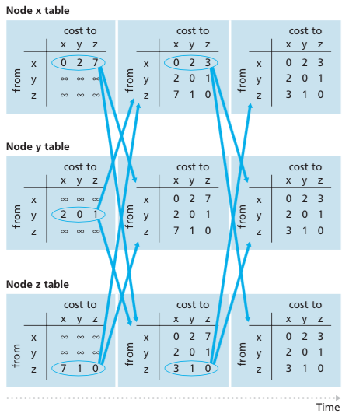
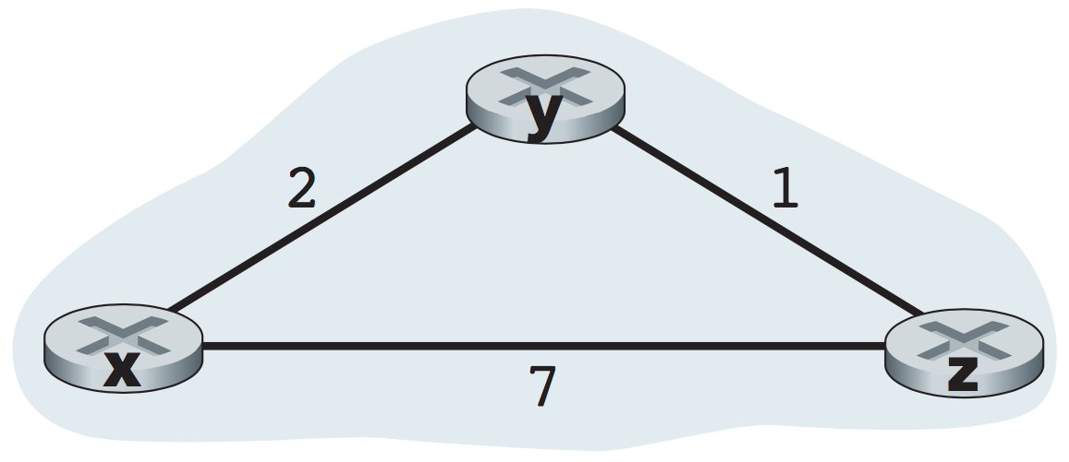
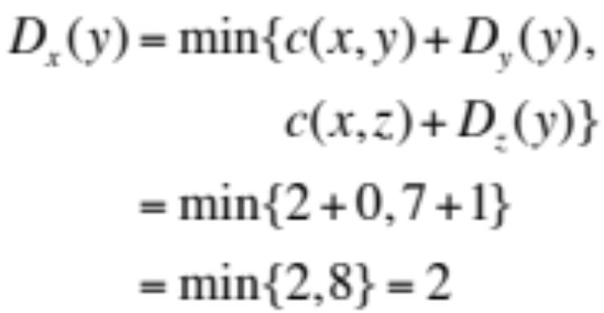
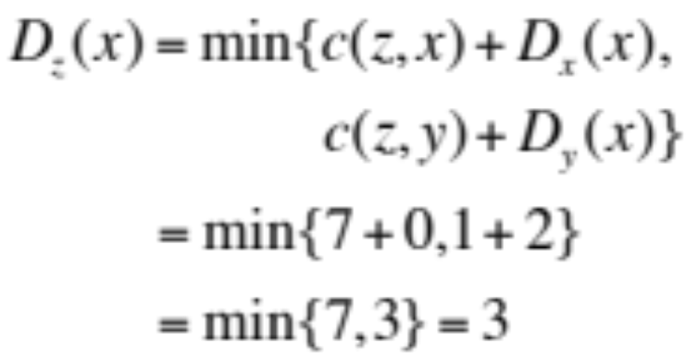
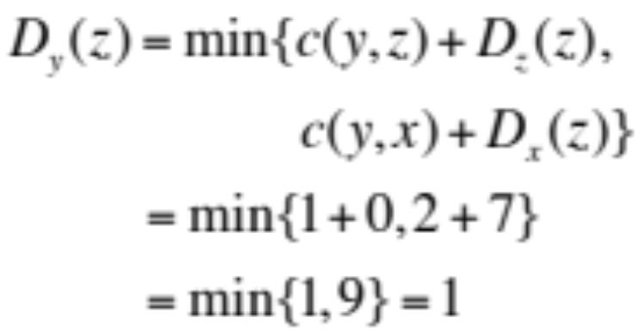
The Distance Vector (DV)
Cost from x to y:
Cost from z to x:
Cost from y to z:
Self-Test

Slide 41
Distance vector: link cost changes
link cost changes:
node detects local link cost change
updates routing info, recalculates local DV
if DV changes, notify neighbors
1
y
4
1
x
z
50
t₀ : y detects link-cost change, updates its DV, informs its neighbors.
“good news
travels fast”
t₁ : z receives update from y, updates its table, computes new least cost to x , sends its neighbors its DV.
t₂ : y receives z’s update, updates its distance table. y’s least costs do not change, so y does not send a message to z.

Slide 42
Distance vector: link cost changes
link cost changes:
node detects local link cost change
“bad news travels slow” – count-to-infinity problem:
60
y
4
1
x
z
50
y sees direct link to x has new cost 60, but z has said it has a path at cost of 5. So y computes “my new cost to x will be 6, via z); notifies z of new cost of 6 to x.
z learns that path to x via y has new cost 6, so z computes “my new cost to x will be 7 via y), notifies y of new cost of 7 to x.
y learns that path to x via z has new cost 7, so y computes “my new cost to x will be 8 via y), notifies z of new cost of 8 to x.
z learns that path to x via y has new cost 8, so z computes “my new cost to x will be 9 via y), notifies y of new cost of 9 to x.
…
see text for solutions. Distributed algorithms are tricky!

Slide 43
Comparison of LS and DV algorithms
message complexity
  LS: n routers, O(n²) messages sent
  DV: exchange between neighbors; convergence time varies
robustness: what happens if router malfunctions, or is compromised?
LS:
  router can advertise incorrect link cost
  each router computes only its own table
DV:
  DV router can advertise incorrect path cost (“I have a really low cost path to everywhere”): black-holing
  each router’s table used by others: error propagate thru network
speed of convergence
LS: O(n²) algorithm, O(n²) messages
  may have oscillations
DV: convergence time varies
  may have routing loops
  count-to-infinity problem

Slide 44
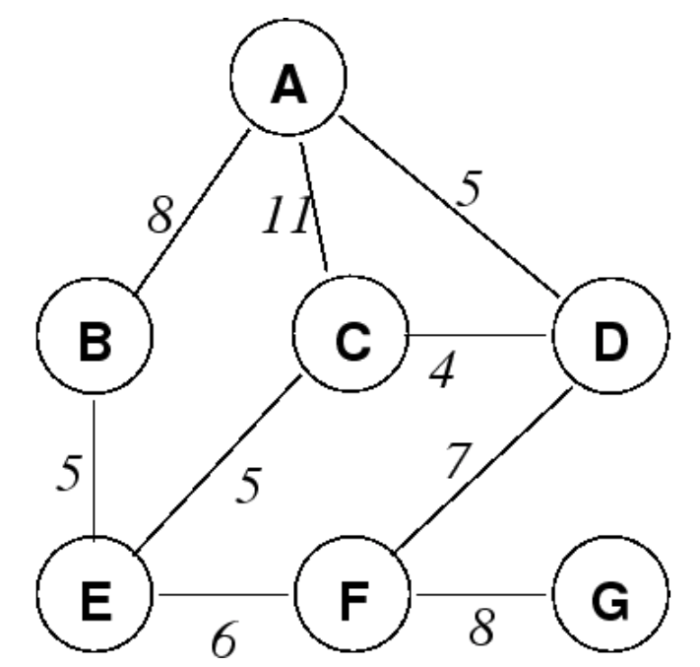
Exercise 5.9
Answer the questions based on the figure and the table with some values that constructed by Bellman-Ford algorithm.
Calculate the cost at w, x and y.
Proof the cost in the blue shaded cells.
Calculate the cost at z. Justify your answer.
 | cost to
from |  | A | B | C | D | E | F | G
 | A |  |  |  |  | w
 | B |  |  |  | x
 | C | y
 | D |  | 13
 | E |  |  |  | 9
 | F |  |  | 11
 | G | z
http://homepages.herts.ac.uk/~comqrgd/docs/network-notes/network-notes-img31.png

Slide 45
Network layer: “control plane” roadmap
introduction
routing protocols
intra-ISP routing: OSPF
routing among ISPs: BGP
SDN control plane
Internet Control Message Protocol (ICMP)
network management, configuration
  SNMP
  NETCONF/YANG (NOT COVERED)

Slide 46
Making routing scalable
our routing study thus far - idealized
all routers identical
network “flat”
… not true in practice
scale: billions of destinations:
can’t store all destinations in routing tables!
routing table exchange would swamp links!
administrative autonomy:
Internet: a network of networks
each network admin may want to control routing in its own network

Slide 47
Internet approach to scalable routing
aggregate routers into regions known as “autonomous systems” (AS) (a.k.a. “domains”)
intra-AS (aka “intra-domain”): routing among within same AS (“network”)
all routers in AS must run same intra-domain protocol
routers in different AS can run different intra-domain routing protocols
gateway router: at “edge” of its own AS, has link(s) to router(s) in other AS’es
inter-AS (aka “inter-domain”): routing among AS’es
gateways perform inter-domain routing (as well as intra-domain routing)

Slide 48
Interconnected ASes
forwarding table configured by intra- and inter-AS routing algorithms
Intra-AS
Routing
Inter-AS
Routing
  intra-AS routing determine entries for destinations within AS
forwarding
table
  inter-AS & intra-AS determine entries for external destinations
intra-AS
routing
3c
3a
inter-AS routing
2c
3b
2a
intra-AS
routing
1c
2b
AS3
intra-AS
routing
1a
1b
AS2
1d
AS1

Slide 49

Inter-AS routing: a role in intradomain forwarding
suppose router in AS1 receives datagram destined outside of AS1:
AS1 inter-domain routing must:
learn which destinations reachable through AS2, which through AS3
propagate this reachability info to all routers in AS1
  router should forward packet to gateway router in AS1, but which one?
3c
3a
2c
other
networks
3b
2a
1c
2b
AS3
other
networks
1a
1b
AS2
1d
AS1

Slide 50
Intra-AS routing: routing within an AS
also known as interior gateway protocols (IGP)
most common intra-AS routing protocols:
RIP: Routing Information Protocol [RFC 1723]
  classic DV: DVs exchanged every 30 secs
  no longer widely used
IGRP/EIGRP: Enhanced Interior Gateway Routing Protocol
  DV based
  formerly Cisco-proprietary for decades (became open in 2013 [RFC 7868])
OSPF: Open Shortest Path First [RFC 2328]
  link-state routing
  IS-IS protocol (ISO standard, not RFC standard) essentially same as OSPF

Slide 51
OSPF (Open Shortest Path First) routing
“open”: publicly available
classic link-state
  each router floods OSPF link-state advertisements (directly over IP rather than using TCP/UDP) to all other routers in entire AS
  multiple link costs metrics possible: bandwidth, delay
  each router has full topology, uses Dijkstra’s algorithm to compute forwarding table
security: all OSPF messages authenticated (to prevent malicious intrusion)

Slide 52
Hierarchical OSPF
two-level hierarchy: local area, backbone.
  link-state advertisements flooded only in area, or backbone
  each node has detailed area topology; only knows direction to reach other destinations
area border routers: “summarize” distances to destinations in own area, advertise in backbone
boundary router: connects to other ASes
backbone
backbone router: runs OSPF limited to backbone
local routers:
flood LS in area only
compute routing within area
forward packets to outside via area border router
area 3
internal
routers
area 1
area 2

Slide 53
Network layer: “control plane” roadmap
introduction
routing protocols
intra-ISP routing: OSPF
routing among ISPs: BGP
SDN control plane
Internet Control Message Protocol (ICMP)
network management, configuration
  SNMP
  NETCONF/YANG (NOT COVERED)

Slide 54
Internet inter-AS routing: BGP
BGP (Border Gateway Protocol): the de facto inter-domain routing protocol
  “glue that holds the Internet together”
allows subnet to advertise its existence, and the destinations it can reach, to rest of Internet: “I am here, here is who I can reach, and how”
BGP provides each AS a means to:
  eBGP: obtain subnet reachability information from neighboring ASes
  iBGP: propagate reachability information to all AS-internal routers.
  determine “good” routes to other networks based on reachability information and policy

Slide 55
eBGP, iBGP connections
2b
∂
2a
2c
1b
3b
2d
∂
1a
1c
3a
3c
AS 2
1d
3d
AS 1
eBGP connectivity
AS 3
logical iBGP connectivity
1c
gateway routers run both eBGP and iBGP protocols

Slide 56
Why different Intra-, Inter-AS routing ?
policy:
inter-AS: admin wants control over how its traffic routed, who routes through its network
intra-AS: single admin, so policy less of an issue
scale:
hierarchical routing saves table size, reduced update traffic
performance:
intra-AS: can focus on performance
inter-AS: policy dominates over performance

Slide 57
Network layer: “control plane” roadmap
introduction
routing protocols
intra-ISP routing: OSPF
routing among ISPs: BGP
SDN control plane
Internet Control Message Protocol (ICMP)
network management, configuration
  SNMP
  NETCONF/YANG (NOT COVERED)

Slide 58
Software defined networking (SDN)
Internet network layer: historically implemented via distributed, per-router control approach:
  monolithic router contains switching hardware, runs proprietary implementation of Internet standard protocols (IP, RIP, IS-IS, OSPF, BGP) in proprietary router OS (e.g., Cisco IOS)
  different “middleboxes” for different network layer functions: firewalls, load balancers, NAT boxes, ..
~2005: renewed interest in rethinking network control plane

Slide 59

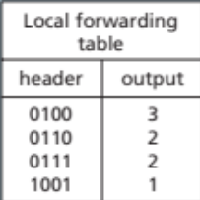
Per-router control plane
Individual routing algorithm components in each and every router interact in the control plane to compute forwarding tables
Routing
Algorithm
control
plane
data
plane
values in arriving
packet header
0111
1
3
2

Slide 60
Software-Defined Networking (SDN) control plane
Remote controller computes, installs forwarding tables in routers
Remote Controller
control
plane
data
plane
CA
CA
CA
CA
CA
values in arriving
packet header
0111
1
3
2

Slide 61
Software defined networking (SDN)
Why a logically centralized control plane?
easier network management: avoid router misconfigurations, greater flexibility of traffic flows
table-based forwarding (recall OpenFlow API) allows “programming” routers
  centralized “programming” easier: compute tables centrally and distribute
  distributed “programming” more difficult: compute tables as result of distributed algorithm (protocol) implemented in each-and-every router
open (non-proprietary) implementation of control plane
  foster innovation: let 1000 flowers bloom

Slide 62
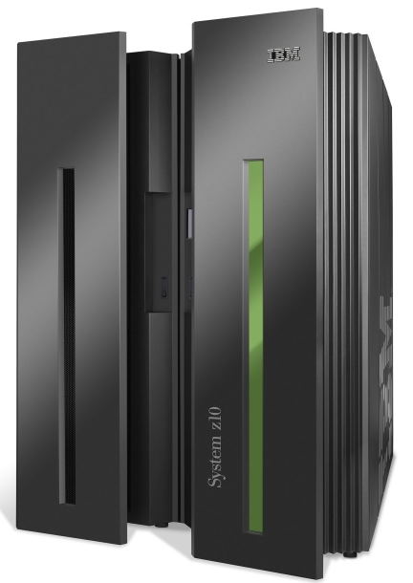




SDN analogy: mainframe to PC revolution
App
App
App
App
App
App
App
App
App
App
App
Specialized
Applications
Open Interface
Specialized
Operating
System
or
or
Windows
Linux
MAC OS
Specialized
Hardware
Open Interface
Microprocessor
Vertically integrated
Closed, proprietary
Slow innovation
Small industry
Horizontal
Open interfaces
Rapid innovation
Huge industry
* Slide courtesy: N. McKeown

Slide 63

Traffic engineering: difficult with traditional routing
5
3
v
w
5
2
u
2
1
z
3
1
2
x
y
1
Q: what if network operator wants u-to-z traffic to flow along uvwz, rather than uxyz?
A: need to re-define link weights so traffic routing algorithm computes routes accordingly (or need a new routing algorithm)!
link weights are only control “knobs”: not much control!

Slide 64
Traffic engineering: difficult with traditional routing
5
3
v
w
5
2
u
2
1
z
3
1
2
x
y
1
Q: what if network operator wants to split u-to-z traffic along uvwz and uxyz (load balancing)?
A: can’t do it (or need a new routing algorithm)

Slide 65
Traffic engineering: difficult with traditional routing
5
3
v
w
5
2
u
2
1
z
3
1
2
x
y
1
Q: what if w wants to route blue and red traffic differently from w to z?
A: can’t do it (with destination-based forwarding, and LS, DV routing)
We learned in Chapter 4 that generalized forwarding and SDN can be used to achieve any routing desired

Slide 66
Software defined networking (SDN)
…
3. control plane functions external to data-plane switches
4. programmable control applications
routing
access control
load
balance
Remote Controller
control
plane
data
plane
CA
2. control, data plane separation
CA
CA
CA
CA
1: generalized “flow-based” forwarding (e.g., OpenFlow)

Slide 67
Software defined networking (SDN)
Data-plane switches:
fast, simple, commodity switches implementing generalized data-plane forwarding in hardware
flow (forwarding) table computed, installed under controller supervision
API for table-based switch control (e.g., OpenFlow)
  defines what is controllable, what is not
protocol for communicating with controller (e.g., OpenFlow)
network-control applications
…
routing
access
control
load
balance
control
plane
northbound API
SDN Controller
(network operating system)
southbound API
data
plane
SDN-controlled switches

Slide 68
Software defined networking (SDN)
SDN controller (network OS):
maintain network state information
interacts with network control applications “above” via northbound API
interacts with network switches “below” via southbound API
implemented as distributed system for performance, scalability, fault-tolerance, robustness
network-control applications
…
routing
access
control
load
balance
control
plane
northbound API
SDN Controller
(network operating system)
southbound API
data
plane
SDN-controlled switches

Slide 69
Software defined networking (SDN)
network-control apps:
“brains” of control: implement control functions using lower-level services, API provided by SDN controller
unbundled: can be provided by 3rd party: distinct from routing vendor, or SDN controller
network-control applications
…
routing
access
control
load
balance
control
plane
northbound API
SDN Controller
(network operating system)
southbound API
data
plane
SDN-controlled switches

Slide 70
Components of SDN controller
routing
access
control
load
balance
interface layer to network control apps: abstractions API
Interface, abstractions for network control apps
…
network graph
RESTful
API
intent
…
network-wide state management : state of networks links, switches, services: a distributed database
statistics
flow tables
SDN
controller
Network-wide distributed, robust state management
…
Link-state info
host info
switch info
…
communication: communicate between SDN controller and controlled switches
OpenFlow
SNMP
Communication to/from controlled devices

Slide 71

OpenFlow protocol
operates between controller, switch
TCP used to exchange messages
  optional encryption
three classes of OpenFlow messages:
  controller-to-switch
  asynchronous (switch to controller)
  symmetric (misc.)
distinct from OpenFlow API
  API used to specify generalized forwarding actions
OpenFlow Controller

Slide 72
OpenFlow: controller-to-switch messages
Key controller-to-switch messages
features: controller queries switch features, switch replies
configure: controller queries/sets switch configuration parameters
modify-state: add, delete, modify flow entries in the OpenFlow tables
packet-out: controller can send this packet out of specific switch port
OpenFlow Controller

Slide 73
OpenFlow: switch-to-controller messages
Key switch-to-controller messages
packet-in: transfer packet (and its control) to controller. See packet-out message from controller
flow-removed: flow table entry deleted at switch
port status: inform controller of a change on a port.
OpenFlow Controller
Fortunately, network operators don’t “program” switches by creating/sending OpenFlow messages directly. Instead use higher-level abstraction at controller

Slide 74
SDN: control/data plane interaction example
Dijkstra’s link-state
routing
1
S1, experiencing link failure uses OpenFlow port status message to notify controller
4
…
network graph
RESTful
API
intent
3
…
2
SDN controller receives OpenFlow message, updates link status info
statistics
flow tables
…
Link-state info
host info
switch info
3
2
Dijkstra’s routing algorithm application has previously registered to be called when ever link status changes. It is called.
…
OpenFlow
SNMP
1
4
Dijkstra’s routing algorithm access network graph info, link state info in controller, computes new routes
s2
s1
s4
s3

Slide 75
SDN: control/data plane interaction example
Dijkstra’s link-state
routing
4
5
…
network graph
RESTful
API
intent
5
link state routing app interacts with flow-table-computation component in SDN controller, which computes new flow tables needed
3
…
statistics
flow tables
…
Link-state info
host info
switch info
2
…
OpenFlow
SNMP
6
controller uses OpenFlow to install new tables in switches that need updating
1
6
s2
s1
s4
s3

Slide 76
SDN: selected challenges
hardening the control plane: dependable, reliable, performance-scalable, secure distributed system
  robustness to failures: leverage strong theory of reliable distributed system for control plane
  dependability, security: “baked in” from day one?
networks, protocols meeting mission-specific requirements
  e.g., real-time, ultra-reliable, ultra-secure
Internet-scaling: beyond a single AS
SDN critical in 5G cellular networks

Slide 77
SDN and the future of traditional network protocols
SDN-computed versus router-computer forwarding tables:
  just one example of logically-centralized-computed versus protocol computed
one could imagine SDN-computed congestion control:
  controller sets sender rates based on router-reported (to controller) congestion levels
How will implementation of network functionality (SDN versus protocols) evolve?

Slide 78
Network layer: “control plane” roadmap
introduction
routing protocols
intra-ISP routing: OSPF
routing among ISPs: BGP
SDN control plane
Internet Control Message Protocol (ICMP)
network management, configuration
  SNMP
  NETCONF/YANG (NOT COVERED)

Slide 79
ICMP: internet control message protocol
used by hosts & routers to communicate network-level information
  error reporting: unreachable host, network, port, protocol
  echo request/reply (used by ping)
network-layer “above” IP:
  ICMP msgs carried in IP datagrams
ICMP message: type, code plus first 8 bytes of IP datagram causing error
Type Code description
0 0 echo reply (ping)
3 0 dest. network unreachable
3 1 dest host unreachable
3 2 dest protocol unreachable
3 3 dest port unreachable
3 6 dest network unknown
3 7 dest host unknown
4 0 source quench (congestion
control - not used)
8 0 echo request (ping)
9 0 route advertisement
10 0 router discovery
11 0 TTL expired
12 0 bad IP header

Slide 80

Traceroute and ICMP
source sends series of UDP segments to destination
  first set has TTL =1
  second set has TTL=2, etc.
  unlikely port number
when datagram in nth set arrives to nth router:
  router discards datagram and sends source ICMP message (type 11, code 0)
  ICMP message include name of router & IP address
when ICMP message arrives, source records RTTs
stopping criteria:
UDP segment eventually arrives at destination host
destination returns ICMP “port unreachable” message (type 3, code 3)
source stops
3 probes
3 probes
3 probes

Slide 81
Network layer: “control plane” roadmap
introduction
routing protocols
intra-ISP routing: OSPF
routing among ISPs: BGP
SDN control plane
Internet Control Message Protocol (ICMP)
network management, configuration
  SNMP
  NETCONF/YANG (NOT COVERED)

Slide 82

What is network management?
autonomous systems (aka “network”): 1000s of interacting hardware/software components
other complex systems requiring monitoring, configuration, control:
  jet airplane, nuclear power plant, others?
"Network management includes the deployment, integration
and coordination of the hardware, software, and human
elements to monitor, test, poll, configure, analyze, evaluate,
and control the network and element resources to meet the
real-time, operational performance, and Quality of Service
requirements at a reasonable cost."

Slide 83

Components of network management
Managed device:
- equipment with manageable, configurable hardware, software components
- managed devices contain
managed objects whose data is gathered into a Management Information Base (MIB)
Managing entity/server: application, typically with network
managers (humans) in the loop
agent
data
managing
entity/server/controller
data
managed device
agent
data
Network management protocol: used by managing server to query, configure, manage device; used by devices to inform managing server of data, events.
agent
data
managed device
managed device
Data: device “state” configuration data, operational data, device statistics
agent
data
agent
data
managed device
managed device

Slide 84
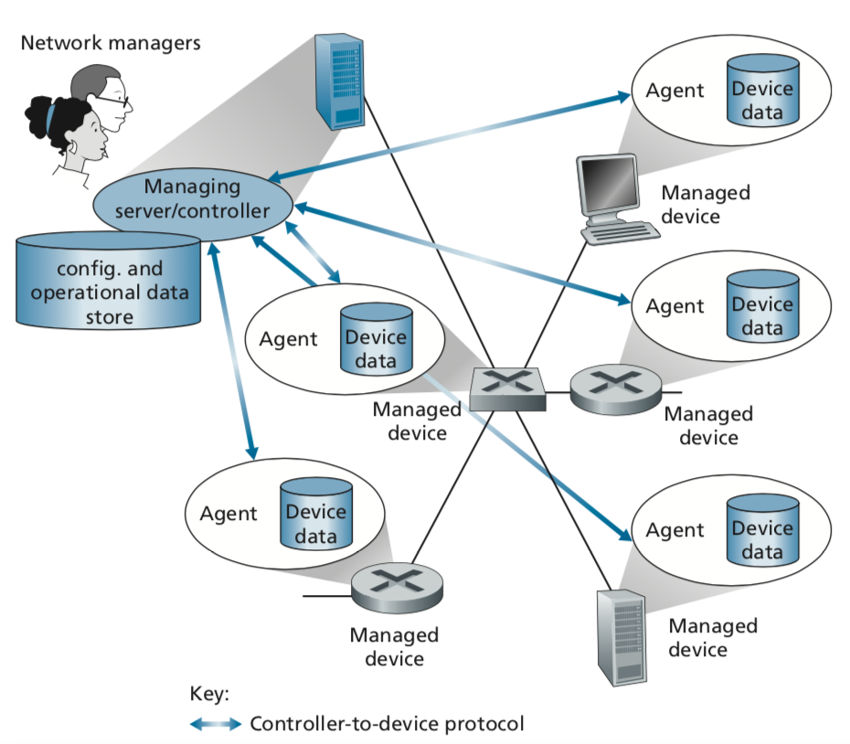
Infrastructure of Network Management
Managed devices contain managed objects whose data is gathered into a Management Information Base (MIB)
Figure: Elements of network management
Kurose, J.F. and Ross, K.W. (2021). Computer Networking: A Top-Down Approach (8th Edition). Pearson Education Limited, England. (pp. 427)

Slide 85
Network operator approaches to management
CLI (Command Line Interface)
  operator issues (types, scripts) direct to individual devices (e.g., vis ssh)
agent
data
managing
entity/server/controller
SNMP/MIB
  operator queries/sets devices data (MIB) using Simple Network Management Protocol (SNMP)
data
managed device
agent
data
agent
data
NETCONF/YANG
  more abstract, network-wide, holistic
  emphasis on multi-device configuration management.
  YANG: data modeling language
  NETCONF: communicate YANG-compatible actions/data to/from/among remote devices
managed device
managed device
agent
data
agent
data
managed device
managed device

Slide 86
SNMP protocol
Two ways to convey MIB info, commands:
data
data
managing
entity/server/controller
managing
entity/server/controller
request
response
trap message
agent
data
agent
data
managed device
managed device
request/response mode
trap mode

Slide 87
SNMP Protocol
(Message Types)
Table: SNMPv3 PDU types
 | Message | Sender-Receiver | Function
1 2 3 | GetRequest GetNextRequest GetBulkRequest | Manager-to-Agent | “Get me data” (data instance, next data in list, block of data)
4 | InformRequest | Manager-to-Manager | Here’s MIB value
5 | SetRequest | Manager-to-Agent | Set MIB value
6 | Response | Agent-to-Manager | Value, response to Request.
 |  | Manager-to-Manager
7 | SNMPv2-Trap | Agent-to-Manager | Inform manager of exceptional event
Protocol Data Unit (PDU)
Kurose, J.F. and Ross, K.W. (2021). Computer Networking: A Top-Down Approach (8th Edition). Pearson Education Limited, England. (pp. 429)

Slide 88
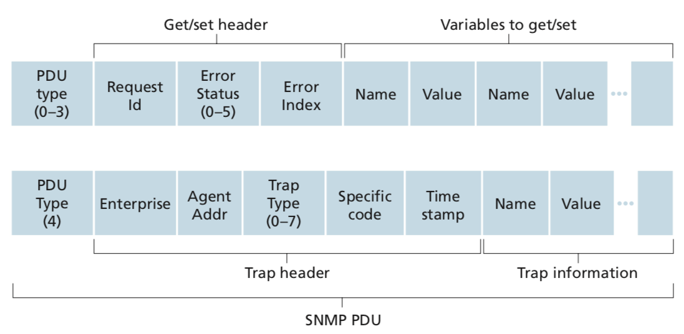
SNMP Protocol
(Message Formats)
message types 0-3
message type 4
Figure: SNMP PDU format
Protocol Data Unit (PDU)
Kurose, J.F. and Ross, K.W. (2021). Computer Networking: A Top-Down Approach (8th Edition). Pearson Education Limited, England. (pp. 430)

Slide 89
SNMP: Management Information Base (MIB)
managed device’s operational (and some configuration) data
gathered into device MIB module
  400 MIB modules defined in RFC’s; many more vendor-specific MIBs
agent
data
Structure of Management Information (SMI): data definition language
example MIB variables for UDP protocol:
Object ID Name Type Comments
1.3.6.1.2.1.7.1 UDPInDatagrams 32-bit counter total # datagrams delivered
1.3.6.1.2.1.7.2 UDPNoPorts 32-bit counter # undeliverable datagrams (no application at port)
1.3.6.1.2.1.7.3 UDInErrors 32-bit counter # undeliverable datagrams (all other reasons)
1.3.6.1.2.1.7.4 UDPOutDatagrams 32-bit counter total # datagrams sent
1.3.6.1.2.1.7.5 udpTable SEQUENCE one entry for each port currently in use

